Slide 1
SC1015
Predicting Heart Disease
By Group 6: Matthew, Izzat, Shaojun

Slide 2
Table of contents
01
02
03
Motivation
Problem Definition
Preparation of Data
04
05
06
Data Analysis
Machine Learning
Conclusions

Slide 3
01
Motivation

Slide 4
Cardiovascular Disease
Makes up 32% of global deaths
Of which 85% are due to heart attacks and strokes
In Singapore, 21 people die from cardiovascular disease every day and it accounted for 32% of all deaths in 2021

Slide 5
02
Problem Definition

Slide 6
Which easily measured factor is the most useful when predicting heart disease for people above 50 years old?
Which model is the best to do this?

Slide 7
03
Preparation of Data

Slide 8
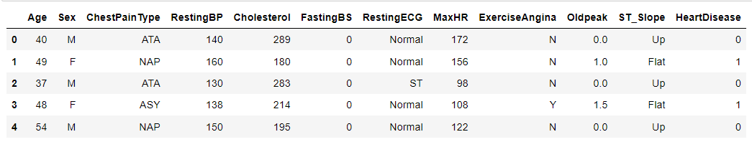
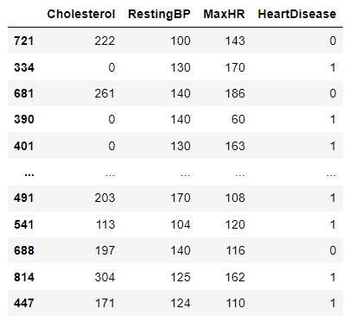
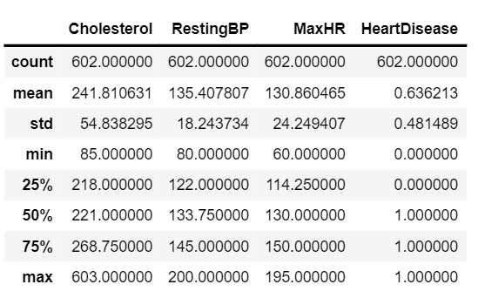

Slide 9
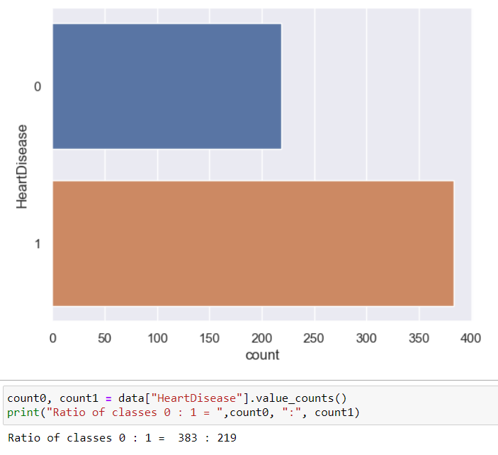
Problem! Class imbalance found which might affect the accuracy of our model!

Slide 10
04
Data Analysis

Slide 11
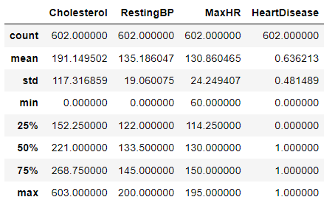
Basic Statistics

Slide 12
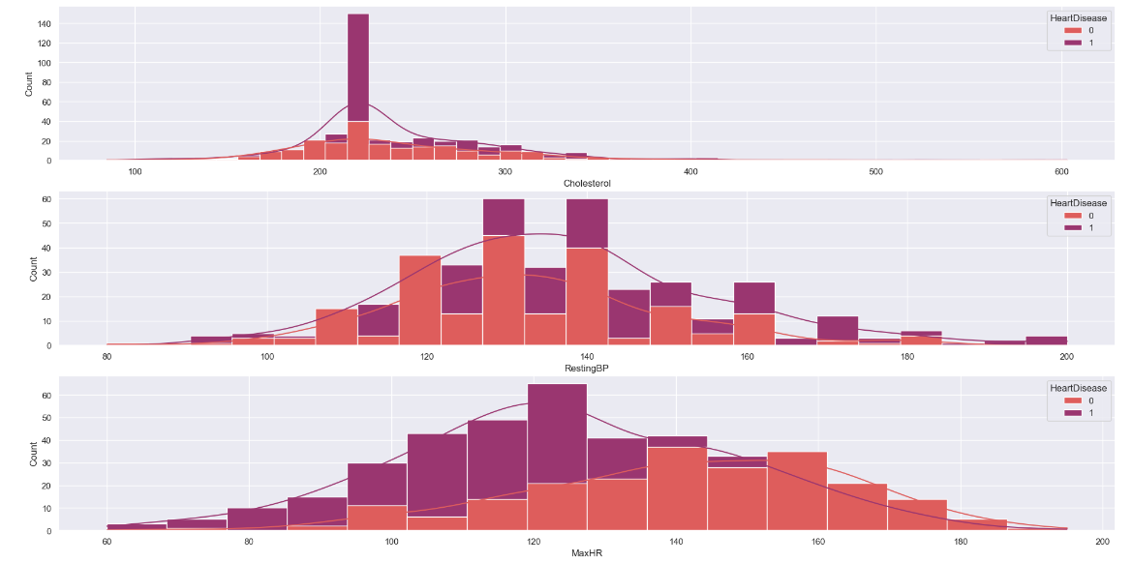
Histogram

Slide 13
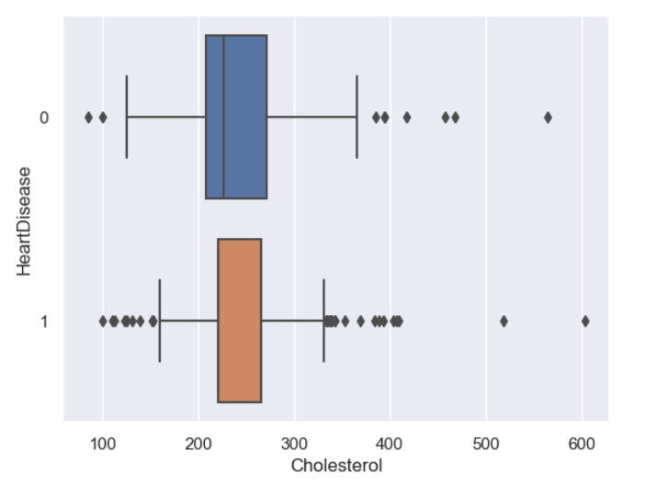
Boxplot

Slide 14
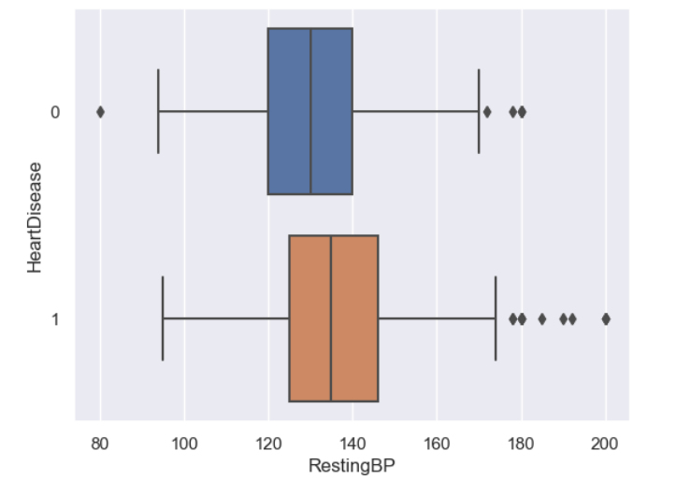
Boxplot

Slide 15
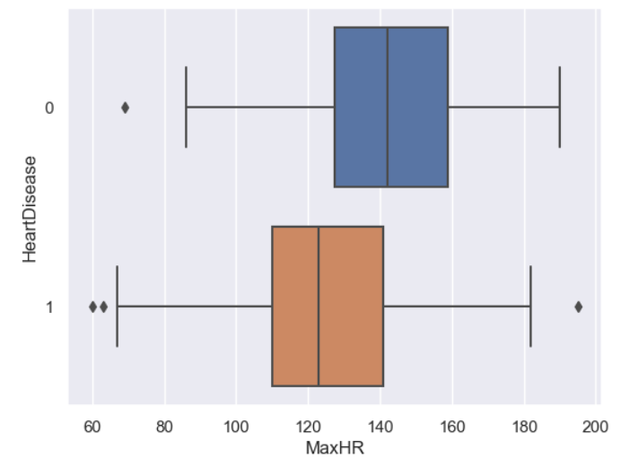
Boxplot

Slide 16
Boxplot

Slide 17
05
Machine Learning

Slide 18
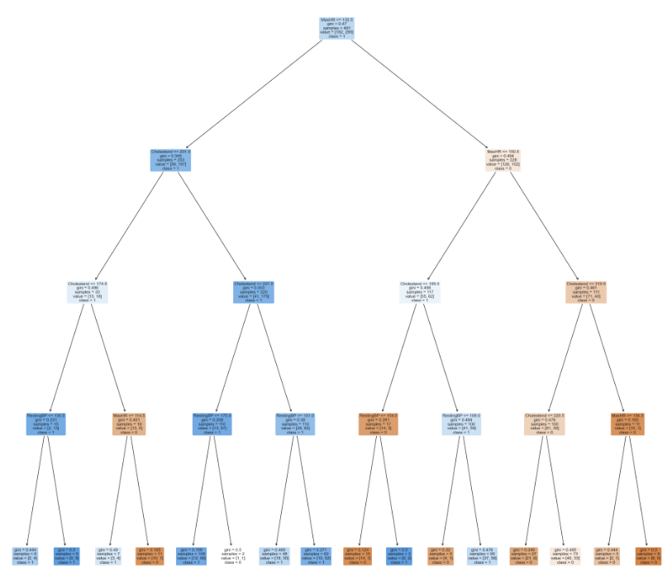
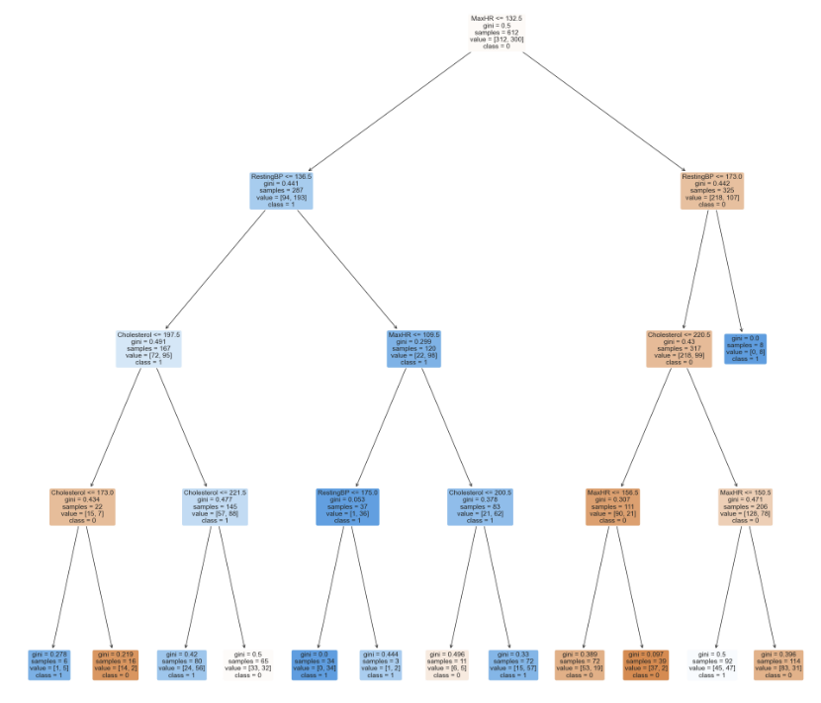
Decision Tree Classification
No Resampling
With Resampling

Slide 19
Logistic Regression
Positive
Negative
e^0.38 = x1.46
1-e^0.38 = -0.46
0.38
-0.38

Slide 20
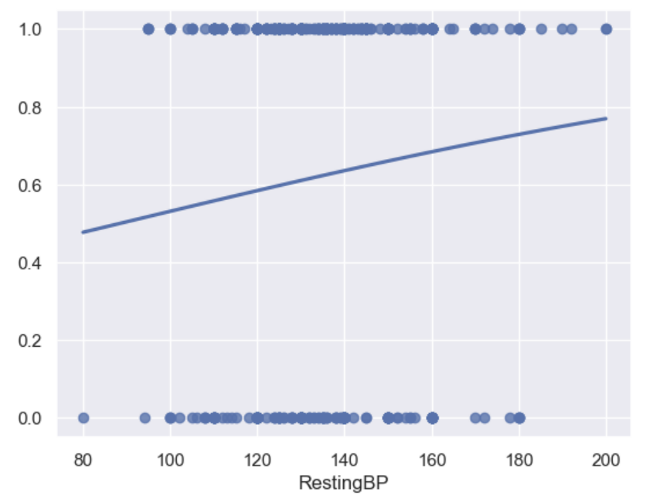
Logistic Regression

Slide 21
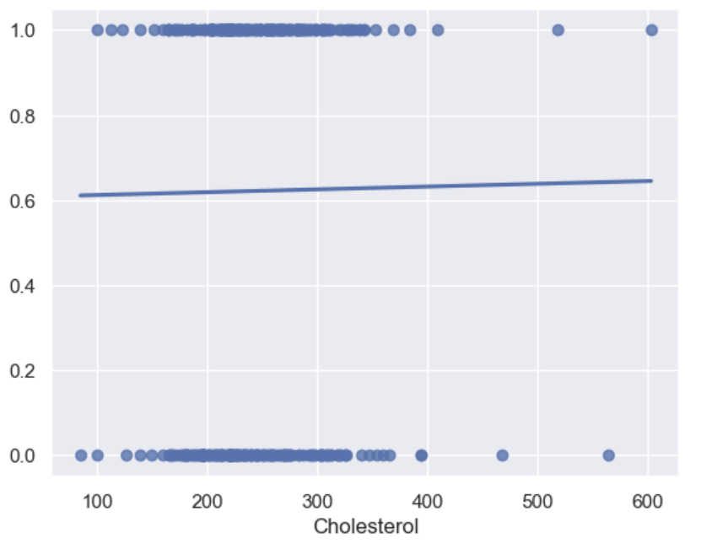
Logistic Regression

Slide 22
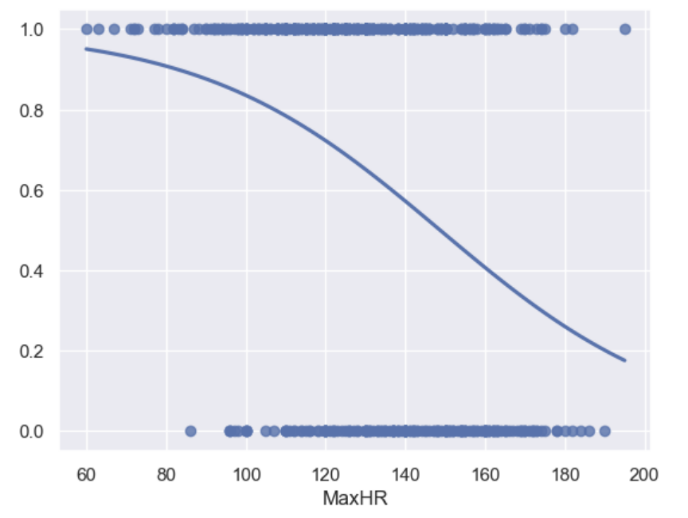
Logistic Regression

Slide 23
Logistic Regression

Slide 24
Max Heart Rate

Slide 26
06
Conclusions

Slide 27
New Things Learnt
Resampling
Logistic Regression
Histogram for categorical variable
01
02
03

Slide 28
THANK YOU!

